Slide 1

APPROXIMATE COMPUTING BASED LOGIC DESIGN
Presented By:
Vedanshi Saini 07211502819
Anushka Gagwari 08611502819
Shreyas Gupta 08911502819
Abir Moitra 35111502817
Guided By:
Proff. Kirti Gupta

Slide 2
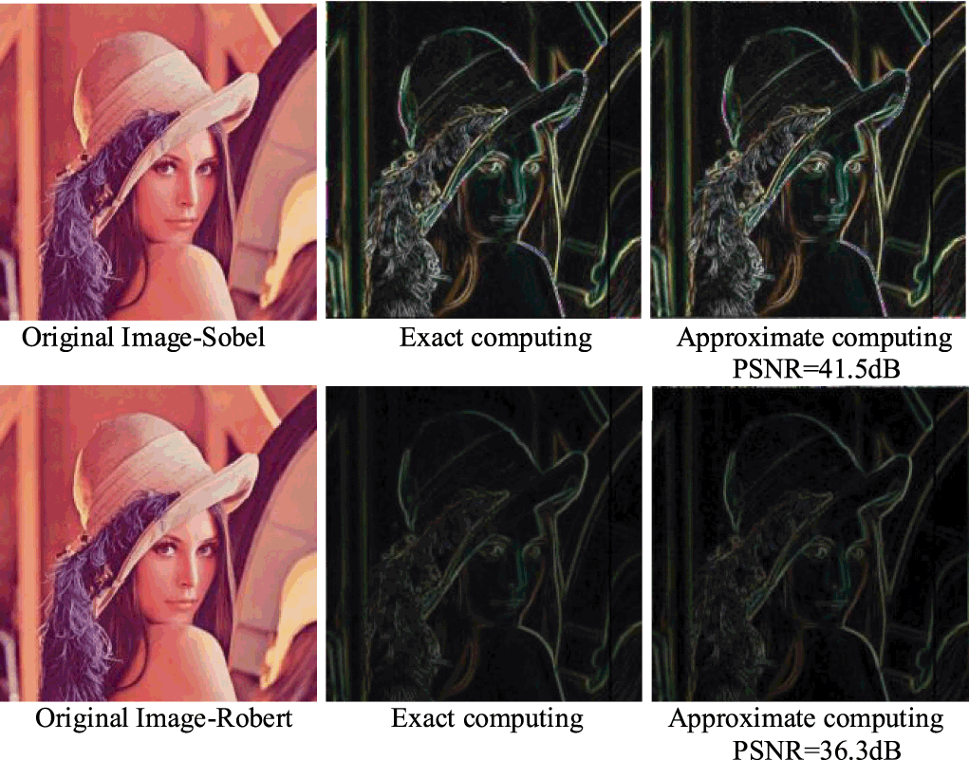
INTRODUCTION
Approximate computing is based on the observation that in many scenarios like multimedia signal processing and data mining, performing exact computation requires large amount of resources, allowing bounded approximation provides disproportionate gains in performance and energy, while still achieving acceptable result accuracy.
Fig 1- Approximate Computing

Slide 3
Need of Approximate Adders
Adders and multipliers shape the key parts in applications like multimedia signal processing and data mining.
Reduce hardware overhead.
A multi-bit adder ignores carry chain, allowing all its sub adders to perform addition operation in parallel.

Slide 4
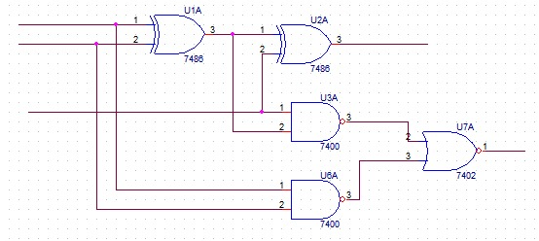
Proposed Methodology
Fig 2- Conventional Full Adder

Slide 5
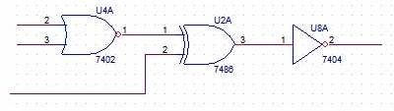
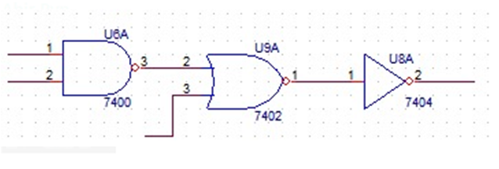
Approximate models of Conventional Adders
Fig 2.1- Approximate Model 1
Fig 2.2- Approximate Model 2

Slide 6
Objectives
The quick development of interest for portable and wireless computing frameworks is driving the requirement for ultra-low power frameworks

